Slide 1

Bapatla Engineering College
Department of Information Technology
Project Review – I
on
AI Based Product Demand and Sales Trend Analysis for Retail Store
By
M. Shankar –Y22AIT475
N. Siva kumari – Y22AIT484
Y. Jitendra Sai-Y22AIT527
P. Lalitha – Y22AIT490
Under the Esteemed Guidance
Dr. B. Krishnaiah
Assistant Professor , M.Tech.,Ph.D
of

Slide 2
content
Problem Statement
Significance of the Problem
Literature Survey
Existing System
Proposed System
Flow Chart
Compare proposed and Existed
Software and hardware Requirements

Slide 3
Problem Statement
Traditional statistical methods often fail to capture complex patterns driven by seasonality, promotions, consumer behavior changes, or external factors such as holidays, pandemics, and supply chain issues. This results in inaccurate demand forecasting, leading to overstocking or stockouts. Inventory optimization remains poor, and sales trends are not analyzed in real time. There is a lack of predictive insights for strategic pricing and promotional decisions. Additionally, manual reporting processes are slow and subjective.

Slide 4
Significance of the Problem
Optimized Inventory – Reduces holding costs and prevents stockouts.
Improved Sales Performance – Better pricing and promotion strategies.
Real-Time Decision Support – Faster responses to market changes.
Enhanced Customer Satisfaction – Ensuring products are available when needed.
Minimizes waste due to unsold stock
Supports seasonal planning
Assists bulk order management with suppliers
Enables automated alerts for low inventory

Slide 5
Literature Survey
Review-1
Title: Smart Inventory & Sales Analytics for Supermarkets
Authors: K. Abdul Majid & G. Kavyashree
Literature Summary: Traditional inventory systems are inaccurate and lead to high costs, stockouts, and wastage in retail stores. Machine learning techniques provide inventory optimization, and sales insights by analyzing patterns and customer behavior.
Drawbacks: Predicting product demand, Sales, Helping supermarkets reduce stockouts and excess inventory.

Slide 6
Literature Survey
Review-2
Title:Big Mart Sales Prediction using Machine Learning
Authors:M. Helen Joseph and V. Sivakumar
Literature Summary: Sales prediction helps businesses plan inventory and resources efficiently, and machine learning techniques improve forecasting accuracy by analyzing sales patterns and seasonality.
Drawbacks:Predictions depend on data quality, may miss sudden market changes, cannot explain why sales fluctuate, and require advanced tools for large datasets.

Slide 7
Existing System
In the existing system, supermarkets rely mainly on manual analysis and basic reports to track product sales and demand. Decisions are based on past experience and simple spreadsheets, which makes it difficult to identify accurate demand patterns, sales trends, and future requirements. This approach is time-consuming, less accurate, and does not effectively handle large volumes of data or changing customer behavior.

Slide 8
Proposed System
system uses historical sales data collected from the retail store database.
The data is cleaned and processed to remove errors, missing values, and irrelevant information.
Important features such as past sales, seasonal effects, and promotional details are extracted to improve prediction accuracy.
After preprocessing, artificial intelligence techniques like machine learning and deep learning models are Theapplied.
These models learn patterns from past data and predict future demand while handling complex and non-linear sales behavior.
The system performs sales trend analysis to identify increasing, decreasing, or stable demand patterns.
The predicted demand and trends are shown through charts and reports to support better inventory planning and business decisions.

Slide 9
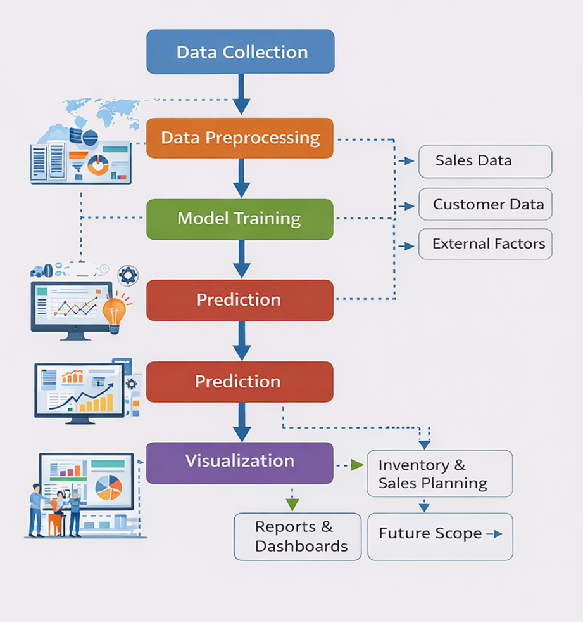
FLOW CHART
Collect sales, customer, and external data
Clean and preprocess the data
Train AI/ML models to predict demand and trends
Visualize results for inventory and sales planning

Slide 10
ADVANTAGES:
Accurate Demand Forecasting
Predicts future product demand more accurately than traditional methods.
Better Inventory Management
Helps avoid overstocking and stock shortages.
Sales Trend Identification
Easily identifies increasing, decreasing, and seasonal sales trends.
Time Saving
Automates analysis and reduces manual work.

Slide 11
Comparison of Proposed and Existing System
Feature | Existing Systems | Proposed System
Demand Prediction Accuracy | Moderate to Low | High (AI + External Features)
Real-Time Updates | Manual / Batch | Automated & Real-Time
External Factor Integration | Limited | Comprehensive
Adaptive Learning | Static Models | Retrainable with New Data

Slide 12
Software and Hardware Requirements
Software Requirements:
Operating System: Windows / Linux
Programming Languages: Python (ML/analysis), JavaScript (Frontend/Backend)
Frontend: HTML, CSS, JavaScript, React.js or Angular (optional)
Backend: Flask, Django, or Node.js
Hardware Requirements:
Intel i5/i7 or equivalent processor
Minimum 8–16 GB RAM
NVIDIA GPU (optional for deep learning models)

Slide 13
conclusion
In conclusion, accurate demand forecasting is essential for the efficient operation of retail stores. Traditional methods are no longer sufficient to handle the complexity and volume of modern retail data. An AI-based demand prediction system provides intelligent, real-time insights that help reduce overstocking and understocking issues. By improving inventory management and sales planning, AI enables retailers to cut costs, enhance customer satisfaction, and make data-driven decisions. Ultimately, adopting AI-driven demand forecasting gives retailers a strong competitive advantage in a dynamic market environment.

Slide 14


